Slide 1

Autonomous Map-Based Space Rover Agent
for Simulated Planetary Exploration
Group 6:
Sadhvi Koli
Aayushi Kadam
CSCI-630: Foundations of Artificial Intelligence
Rochester Institute of Technology
April 2026

Slide 2
What should a rover prioritize ?
shortest path?
collecting all resources?

Slide 3
Problem Statement
Autonomous rover navigating a simulated planetary grid
Limited energy and time constraints
Must:
Avoid obstacles
Collect resources
Use charging stations
Key Challenge
| How should the rover decide its actions efficiently under constraints?
Core Question
| Should the rover prioritize efficiency or resource collection?

Slide 4
Background
DQN → Best overall performance (generalization)
MD-DQN → Faster initial learning (transfer)
Q-Learning → Less stable (limited representation)
Rule-Based → Safe but inefficient (no learning)
Autonomous navigation is critical in:
Space exploration
Robotics
AI decision-making systems
Traditional approaches:
Rule-based → fixed, limited adaptability
Reinforcement Learning → learns from interaction
Hypothesis

Slide 5
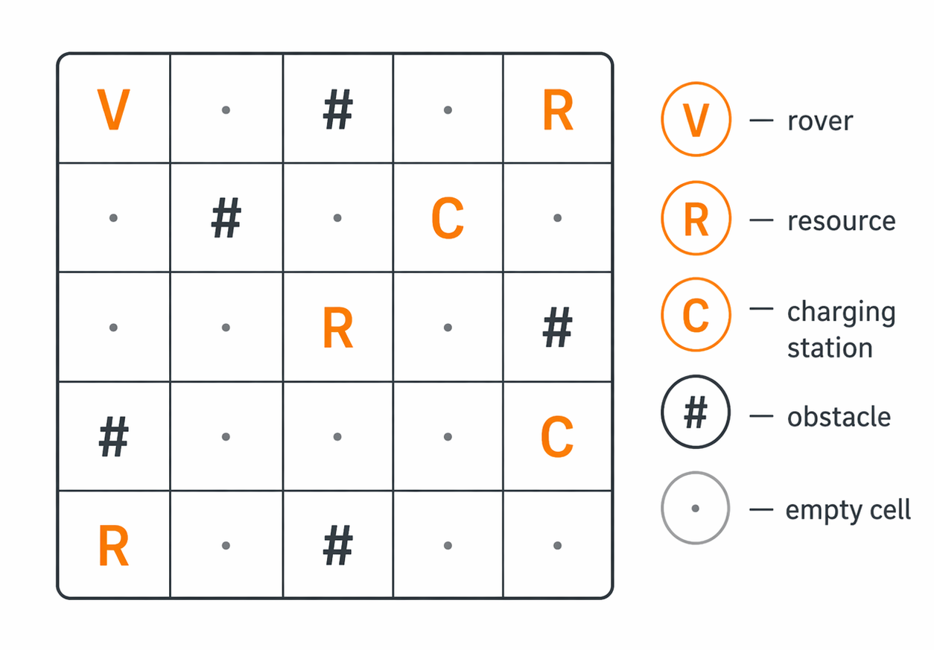
ENVIRONMENT
Simulated Dataset (Environment)
Grid-based map (e.g., 8×8)
State Space
Position: (x, y)
Energy level
Action Space
Up • Down • Left • Right
Reward Design
+10 → Resource collected
-0.1 → Step cost
-5 → Collision
+5 → Recharge
Components:

Slide 6
Objective
| Maximize total reward while navigating efficiently
Balancing:
Resource collection
Energy consumption
Safety (avoid collisions)

Slide 7
Modeling Approaches
Model | Type | Key Idea
Rule-Based | Baseline | Fixed decision rules
Q-Learning | RL (Tabular) | Learns from experience
DQN | Deep RL | Neural network approximation
MD-DQN | Transfer RL | Uses pretrained knowledge

Slide 8
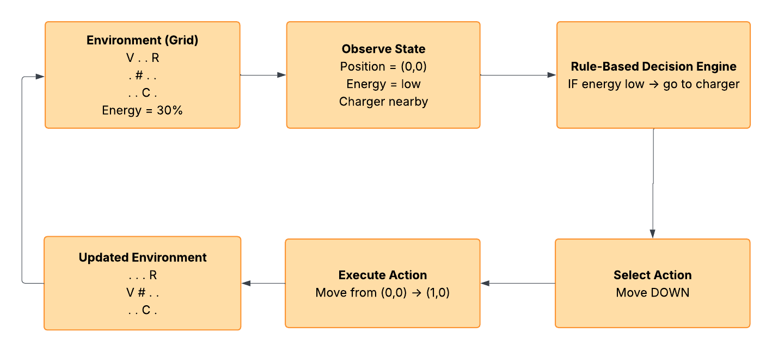
Rule-Based
Uses predefined decision rules (no learning)
Observes current state:
Position, energy, nearby cells
Applies simple logic:
Low energy → move to charger
Resource nearby → move toward resource
Otherwise → explore
Key Characteristics
Deterministic behavior
Fast and simple
No adaptation over time
Limitation
Performance depends on rule design
Cannot improve with experience
May be inefficient in complex environments
(repeat)

Slide 9
Q-Learning
Q-Learning
Reinforcement learning algorithm
Learns action values through interaction with the environment
Stores knowledge in a Q-table
Q(s,a)←Q(s,a)+α[r+γmaxa′​Q(s′,a′)−Q(s,a)]
Policy
Uses ε-greedy strategy:
Explore → random action
Exploit → best-known action
Hyperparameters
α → Learning rate = 0.1
γ → Discount factor = 0.9
ε → Exploration rate = 1.0 → 0.1 (decay = 0.99)
Key Idea
Learns optimal policy through trial and error
Limitation
Works well for small state spaces
Poor scalability in larger environments
Can be unstable

Slide 10
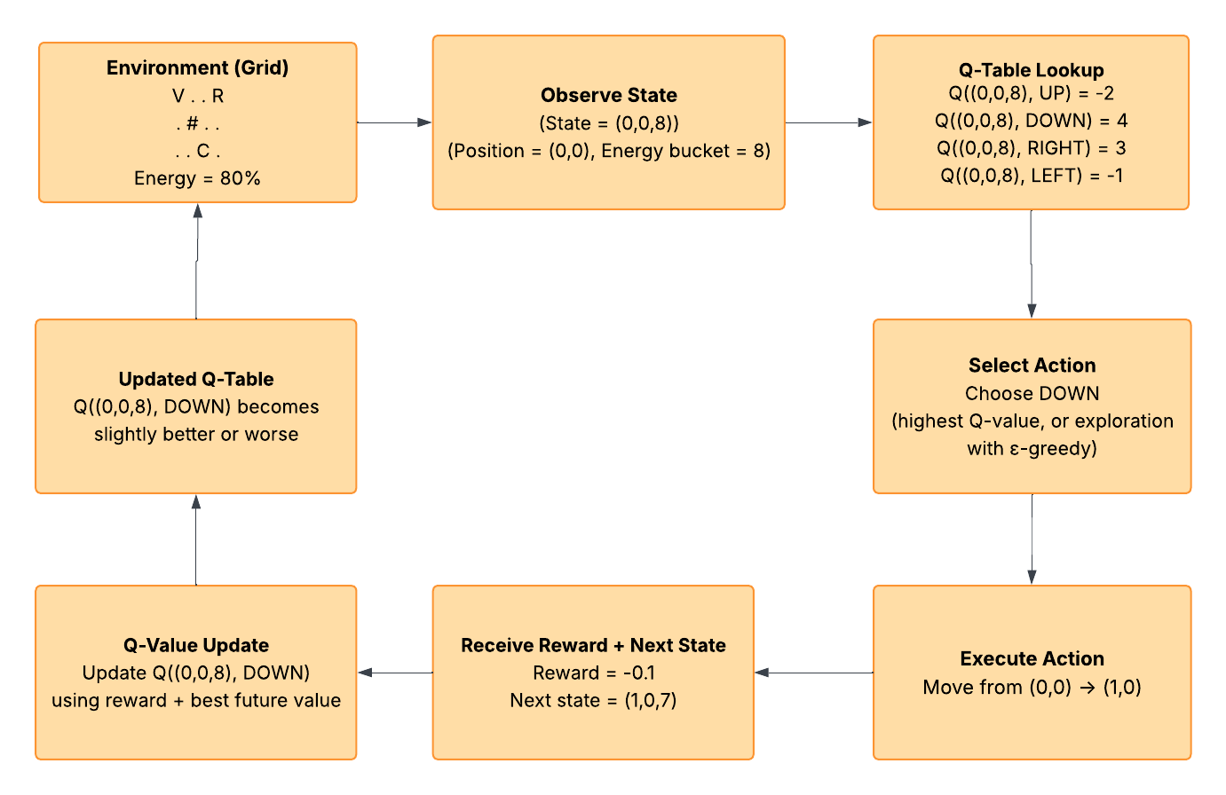
(repeat)
Q-Learning

Slide 11
DQN (Deep Q-Network)
Deep Q-Network (DQN)
Extension of Q-learning using neural networks
Approximates Q-values instead of storing them in a table
Handles large and complex state spaces
L=E[(r+γmax a ′​Qtarget​(s′,a′)−Q(s,a))^2]
Key Components
Neural Network → 2-layer MLP (128 units, ReLU)
Replay Buffer → stores past experiences
Target Network → stabilizes training
Policy
Uses ε-greedy strategy
Explore → random action
Exploit → best predicted action
Hyperparameters
α → Learning rate = 0.001
γ → Discount factor = 0.99
ε → Exploration rate = 1.0 → 0.05 (decay = 0.99)
τ → Target update frequency = 20
B → Batch size = 64
Key Idea
Learns generalized policies using neural networks
Advantage
Scales to large state spaces
More stable than Q-learning

Slide 12
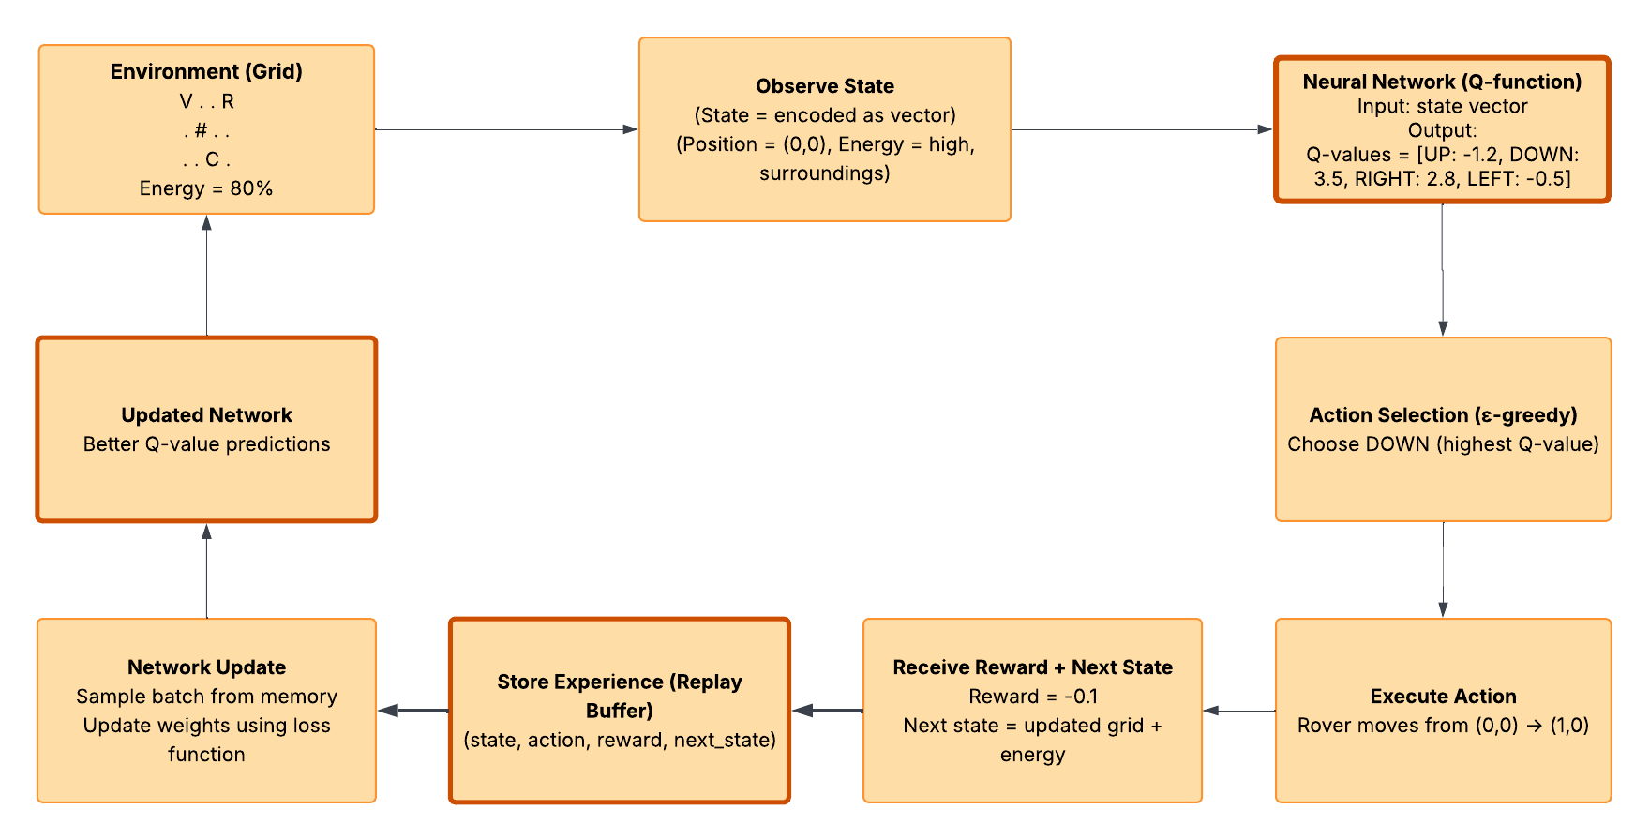
Deep Q-Network

Slide 13
MD-DQN (Multi-Domain DQN)
MD-DQN (Multi-Domain DQN)
Extension of DQN with transfer learning
Uses a pretrained DQN model to guide learning
Combines:
learned knowledge (source)
new experience (target)
Modified Target (Key Idea)
y=max(r+γmax a ′ ​ Q target ​ (s ′ ,a ′ ),Q source ​ (s,a))
Key Components
Source Network → pretrained knowledge
Target Network → current learning
Replay Buffer → experience storage
Policy
Uses ε-greedy strategy
Explore → random action
Exploit → best predicted action
Key Idea
Accelerates learning by leveraging prior knowledge
Advantage
Faster initial learning
Better performance in similar environments
Limitation
Depends on similarity between source and target
Can introduce instability

Slide 14
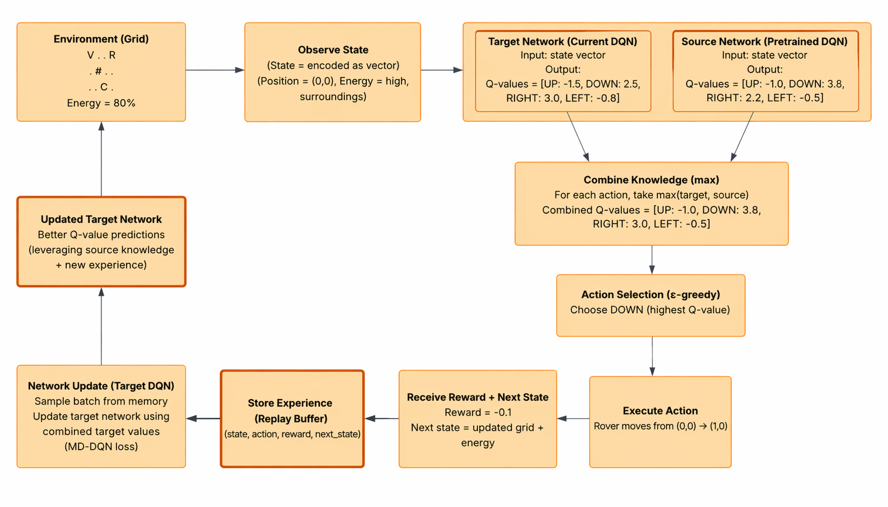
MD-DQN

Slide 15
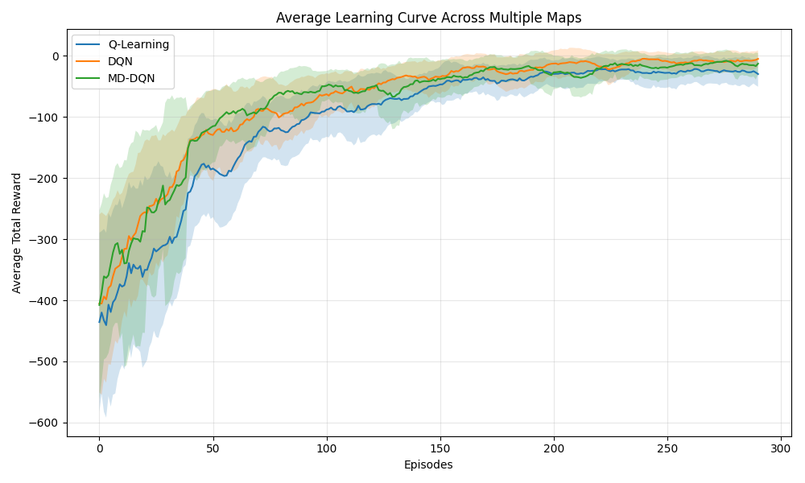
Learning Curve
Key Observations
DQN shows stable and consistent improvement
MD-DQN learns faster in early episodes
Q-learning is slower and more unstable
Variance bands indicate learning stability

Slide 16
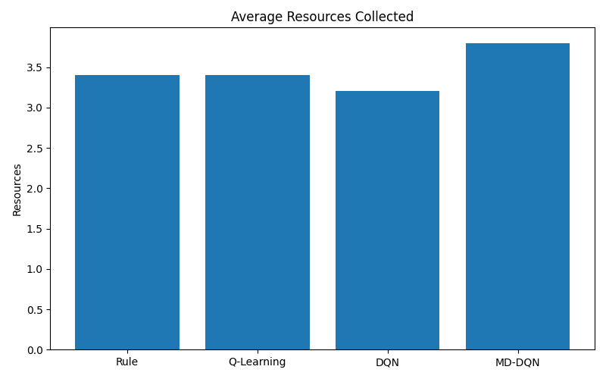
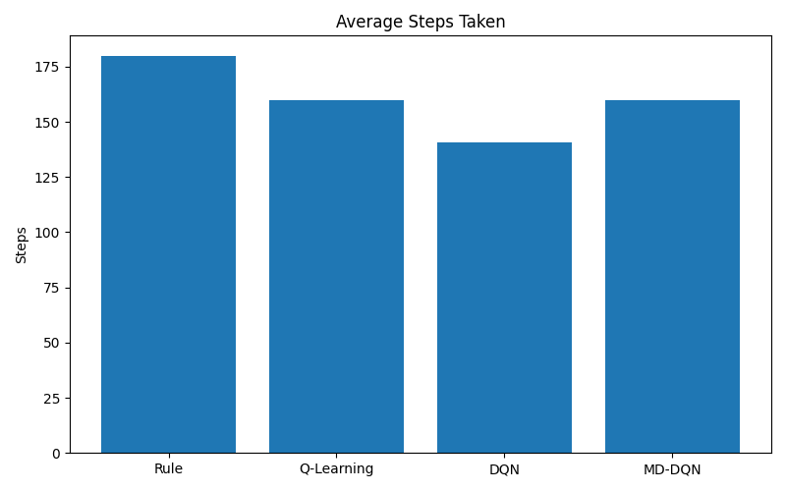
Resources + Steps
Key Findings
MD-DQN collects most resources
DQN takes fewest steps (most efficient)
Rule-based is slow and less optimal

Slide 17
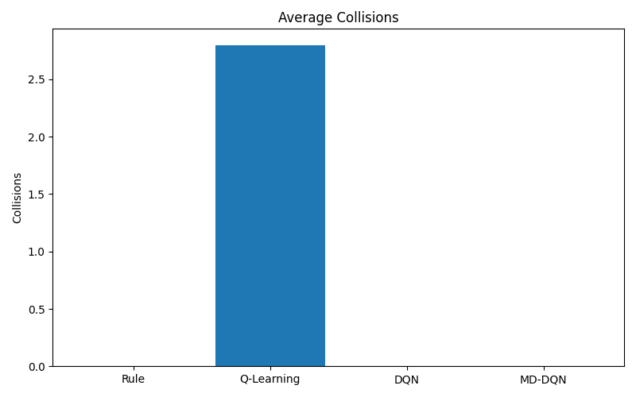
Rewards + Collisions
Reward & Safety Analysis
MD-DQN achieves highest reward
DQN performs consistently well
Q-learning has collisions and poor reward
Rule-based is safe but inefficient

Slide 18
Overall Performance Comparison
Model | Resources | Steps | Reward | Collisions
Rule-Based | 3.4 | 180 | -2.0 | 0
Q-Learning | 3.4 | 160 | -26.0 | 2.8
DQN | 3.2 | 140.8 | 3.84 | 0
MD-DQN | 3.8 | 160 | 6.0 | 0
Key Takeaways:
MD-DQN → Highest reward & resource collection
DQN → Most efficient (fewest steps)
Q-learning → Unstable, causes collisions
Rule-based → Safe but inefficient
Results averaged over 5 randomized environments

Slide 19
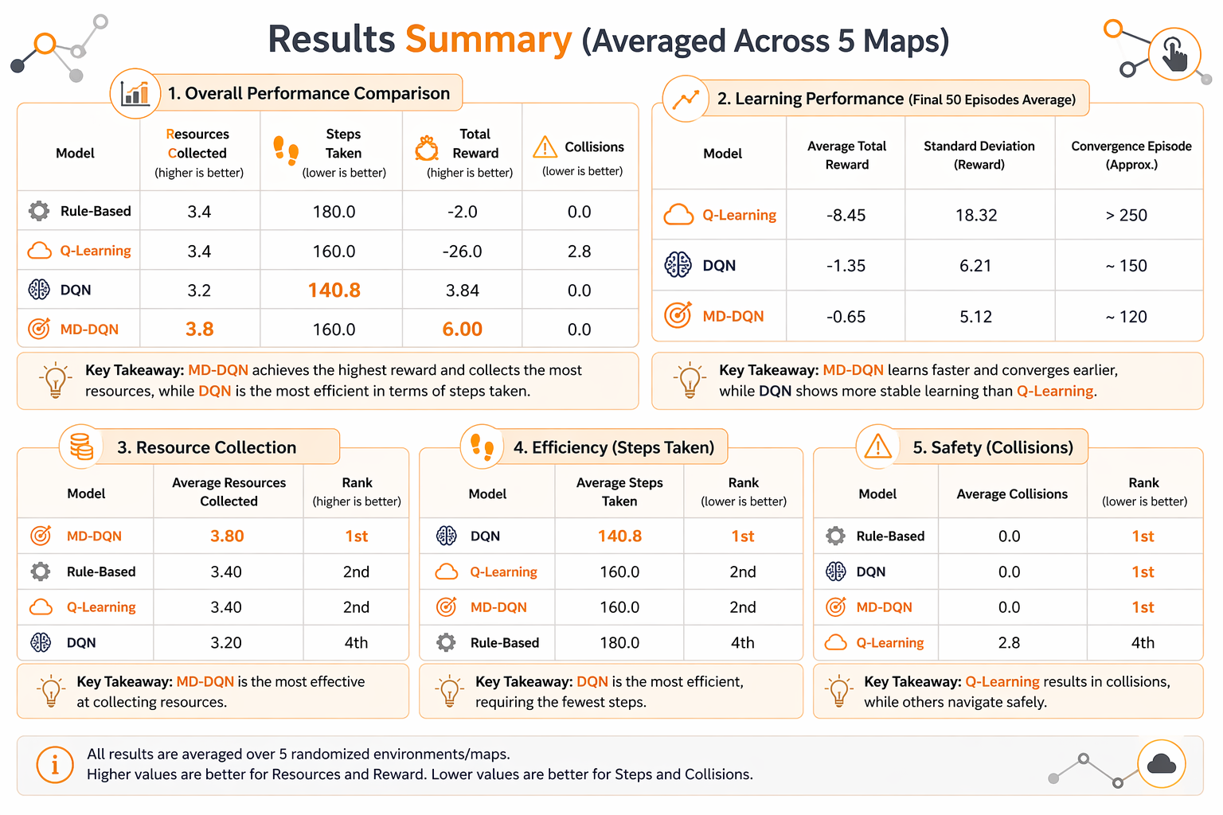

Slide 20
Conclusion
DQN provides the best balance of efficiency and stability, while MD-DQN achieves higher rewards through transfer learning. Overall, learning-based approaches outperform rule-based methods, highlighting a trade-off between efficiency and reward.

Slide 21
Future Work
Test on larger and more complex maps
Improve transfer learning strategies
Extend to real-world robotics scenarios
Visualizing agent behavior on a dynamic map

Slide 22
References
Sutton, R. S., & Barto, A. G. (2018). Reinforcement Learning: An Introduction. MIT Press
Mnih, V., Kavukcuoglu, K., Silver, D., et al. (2015). Human-level control through deep reinforcement learning. Nature
Liu, X., Jeong, J., Taitler, A., Gimelfarb, M., & Sanner, S. (2025). ModelDiff: Symbolic Dynamic Programming for Model-Aware Policy Transfer in Deep Q-Learning. AAAI https://doi.org/10.1609/aaai.v39i25.34864

Slide 23
Thank you

